Slide 1
Factoral and Sectoral Characteristics of China's Growth since the Reform
Reporter
Li, Hongcheng

Slide 2
Objective
To understand China Miracle
Unprecedented speed and massive scale of economic growth.
What are the characteristic patterns in this growth?
What are the underlying forces driving these patterns?
Market and opening? Government and state? Sustainable?
To compare and mitigate different views in literature
The role of different factors
Capital v.s. TFP
The rise of capital growth
Reform v.s. State
...

Slide 3
Objective
What are factoral and sectoral patterns?
Factoral growth accounting
TFP + Capital + Labor + Human Capital.
The contribution each factor makes to the total growth.
Relation between factoral behavior and reforms/impacts.
Sectoral labor migration
Structural transformation from one sector to another.
Economic incentives driving this transformation.
Institutional barriers stymieing this transformation.

Slide 4
History
We divide the history of reform into four periods
1978-1991
Political and Tentative Economic Trials
Liberation of political ideology.
Agricultural price reform.
HRS, the early 1980s.
Divisive event: South Talk in 1992.
1992-2001
Economic Reforms
Land reforms and market liberalization.
Price reform over food and housing, financial market, ...
Divisive event: China joining WTO in 2001

Slide 5
History
2002-2008
WTO and Open
Reforms focusing on baking and finance.
International trade.
Burgeoning secondary and tertiary industries.
Divisive event: Global Crisis in 2008.
2009-2017
Global Crisis and “One Belt, One Road”
Coping measure: monetary and fiscal policy stimulus.
Short rise of investment's role.

Slide 6
Data: General Description
Three data sources
China Statistical Yearbook, 1999-2018
Our main data source: complete categories and long time span.
Yields results consistent with literature.
China's National Income, Hsueh and Li (1999)
The same origin as yearbook, State Statistical Bureau.
Complementary source: investment data, and labor income share.
Penn World Table 9.1
Complementary source: human capital.
Human capital only takes a modest role,
So we omit the distortion brought by this data combination.
To be compared with our main results.
Yields curious results and lacks sectoral data.

Slide 7
Data: Investment
The data on capital accumuation/investment is seriously missed
Aggregate data: 1997-2017
Sectoral data: 2003-2017 (primary), 2006-2017 (secondary and tertiary)
Solution
Aggregate investment: completed with Hsueh and Li's (1999).
Justification: both sources come from the same origin.
Sectoral investment: Two-Step Extension

Slide 8
Data: Investment, Two-Step Extension
For sectoral investment, we first apply a two-step method to complete investment data of primary sector.
The first extension: we employ Brandt and Zhu's (2010) method of assuming that household investment be proportional to income; and we also assume that investment on AFHF (农林牧渔) be proportional to agricultural investment.
K_p = K_pea * Y_p / Y + K_nonpea_AFHF * Y_p / Y_AFHF
This extends the data to 1995.
The second extension: we learn the spirits of the first extension, and assume that investment of similar categories varies proportionally to each other; then we list many kinds of investment found in yearbook, and select three that are most proportional to our firstly extended data and use them to predict the investment data back to 1986.

Slide 9
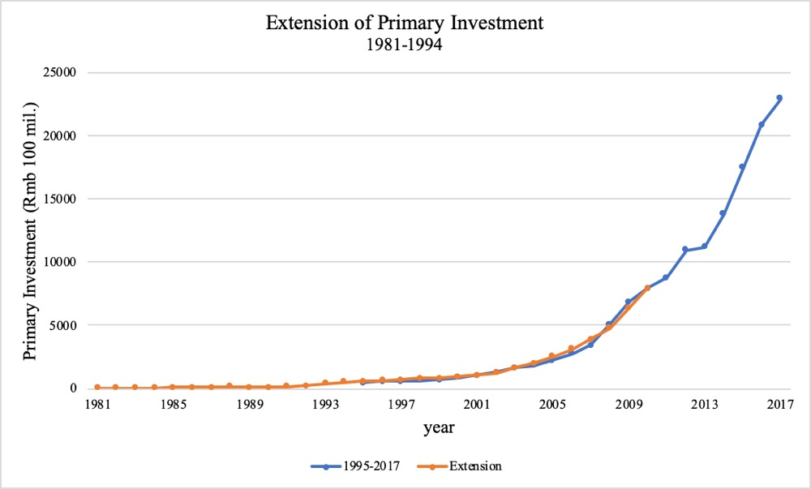
Data: Investment, Two-Step Extension
Justifications
One may criticize that our second extension seems cursory, but the figure on the right presents the qualification of this method, as the proportionally predicted data fits perfectly with both the original and first-extended data within the overlap.
The consistancy between our later results and conclusion of literature also justifies this two-step method.

Slide 10
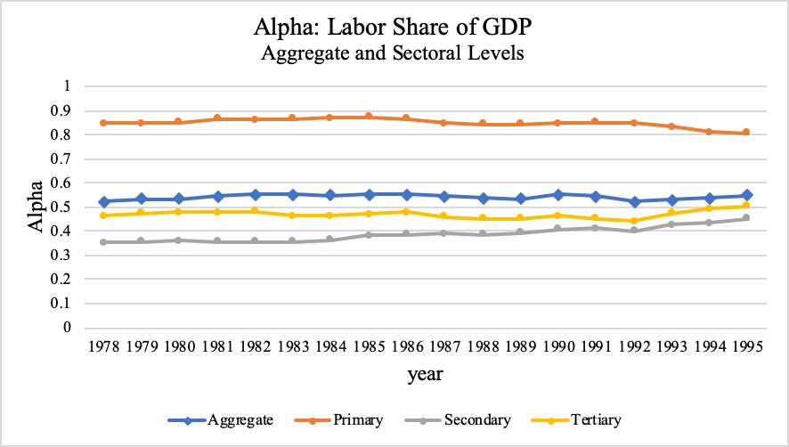
Data: Labor Income Share
We use detailed industrial data from Hsueh and Li's (1999) to calculate the labor income share at each level and for each sector.
Notice that these values appear to be very stable in the long run, so we set them as constant in later analysis.
Aggregate = 0.541
Primary = 0.850
Secondary = 0.389
Tertiary = 0.470
Non-primary = 0.429

Slide 11
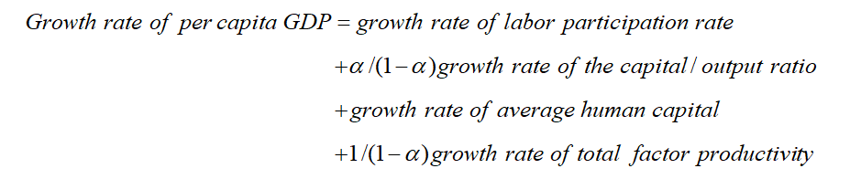
Factoral Analysis: Method
We follow Zhu's (2012) accounting method

Slide 12
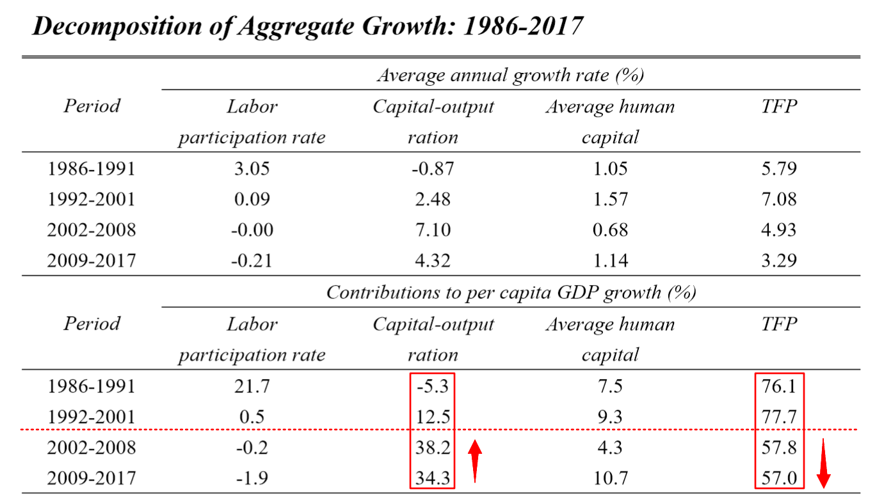
Factoral Analysis: Aggregate Result
somewhat interchange of role

Slide 13
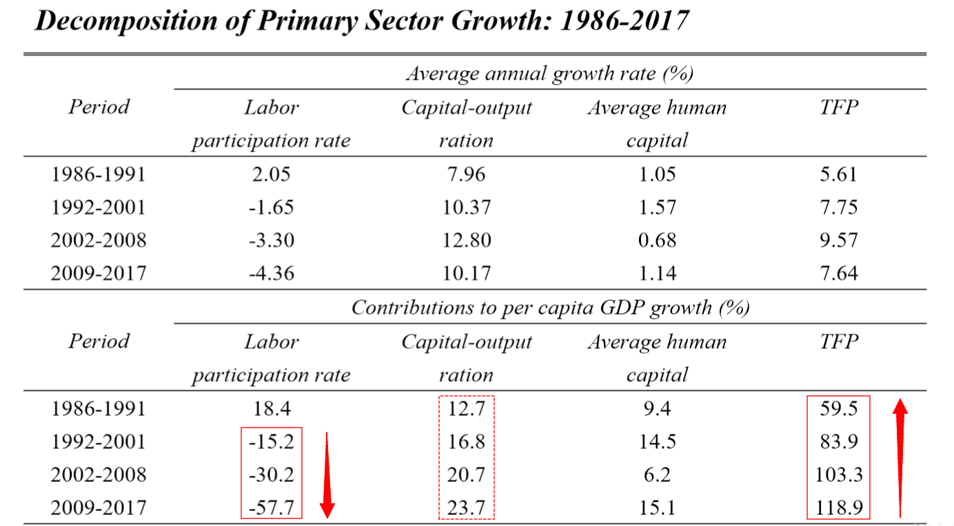
Factoral Analysis: Agricultural Result
<------- 5 to 6 times -------
complete TFP-driven

Slide 14
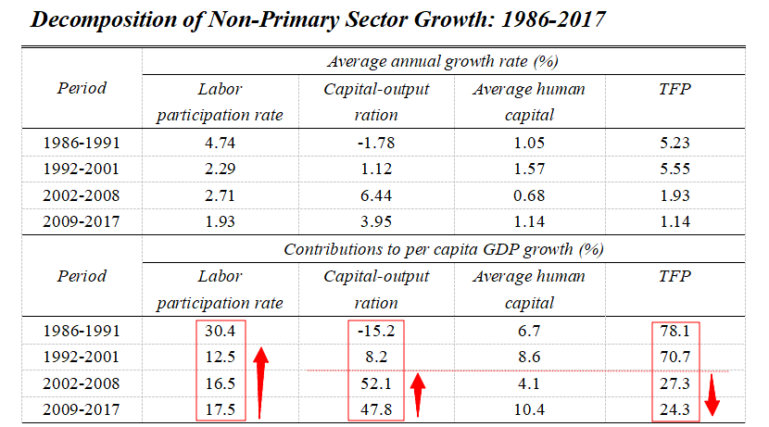
Factoral Analysis: Non-Agricultural Result
complete interchange of role

Slide 15
Factoral Analysis: Summary
Agricultural growth: powerful TFP growth
The absolute value of TFP growth rate remains high but stable.
TFP's increasing contribution is due to fast labor migration.
Non-agricultural growth: rising role of capital growth
Aggregate Patterns:
Structural transformation.
Deepening capital-dependence.
These results are consistent with the literature
e.g., Chen, Jefferson, and Zhang (2011); Brandt, Hsieh, and Zhu (2008).

Slide 16
Sectoral Analysis: MPR
Theoretical background: An ideal two-sector labor market should gives balanced wages in both sectoral labor markets.
Assumptions
A1: No inter-sectoral migration friction and regulation.
A2: Labor forces needed respectively in two labor markets are interchangable.
No discrepancy in human capital, living cost, etc..
*A3: No in-sectoral migration friction and regulation.
Model Price Ratio (MPR): The ratio of theoretical labor wage of one sector to that of primary sector deduced from C-D production func.

Slide 17
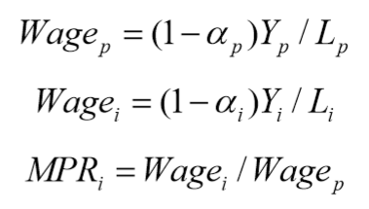
Sectoral Analysis: MPR
Formally, we have:
In principle, MPR is equal to 1, which is not very likely. The deviation of realized MPR from theoretical value indicates that the three assumptions A1-3 do not all hold true.
We will later justify that this deviation is an adequate indicator of migration restriction. Therefore, the gap between MPR and 1 is directly related to structural transformation.

Slide 18
Sectoral Analysis: MPR, Justifications
The first justification
Assumption 2 may be violated: discrepancy between labor forces in primary and non primary industry is not negligible, such as, urban-rural income inequality, education inequality, etc..
However, in the long-term sense, these differences can also be regarded as part of migration restrictions.
The notion wage here contains not merely income, but also all aspects concerning economic incentives, the benefit-cost structure faced by individuals.
The higher cost of living in cities and being educated actually forms a barrier for an individual with rural household registration, when he plans for the future.
Thus, the migration restrictions of our interest does not only contain friction and regulation, but also urban-rural economic gap.

Slide 19
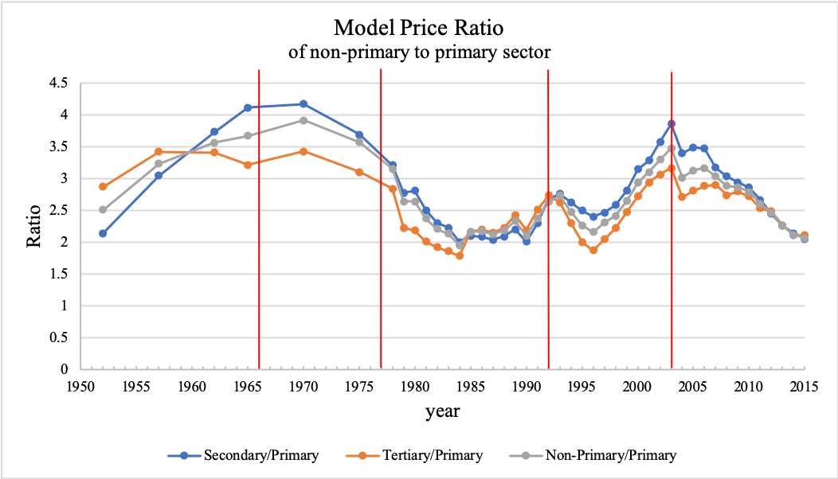
Sectoral Analysis: MPR, Justifications
The second justification
Three dropping periods of MPR fit perfectly with three historical events.
1. The end of the Great Cultural Revolution in 1976, starting the unchain-ment of market liquidity.
2. The South Talk in 1992, mobilizing local governments to embrace all-round economic reform.
3. The end of the gradual implementation of the rural-to-non-rural (农转非) policy during 1998-2003, breaking the strict restrictions on u-r migration.
Events that either rise the demand or reduce the friction engender MPR decline.

Slide 20
Sectoral Analysis: MPR, Justifications
The third justification
We define the counterpat notion for capital, Model Price Ratio of Capital (MPRC), the theoretical rent level of one sector to that of primary sector.
The fact that capital flow enjoys more liquidity should give that MPRC will stay close to theoretical value 1 when capital market is developed.
As expected, after 2001, both the establishment of domestic capital market and the opening of international market make MPRC stay around 1.
This proves that when migration friction is low, MPR will approach 1, and this futher ensures that 1 is indeed a referrence point for MPR.

Slide 21
Sectoral Analysis: Summary
MPR is justified as an adequate indicator for migration restriction.
MPR, as shown on the right, remains much higher than theoretical value, and this implies the existence of both demand and friction of structural transformation.
More importantly, the concurrence of MPR's deviation and the structural transformation identified previously indirectly tells that China's massive inter-sectoral labor migration trend is indeed driven by economic incentives, and thus, this trend serves as a phenomenal growth pattern contributing to China Miracle.

Slide 22
Patterns: TFP and Capital
Why did TFP grow rapidly in non-primary sector before 2001?
A series of State-owned Enterprise Reform (SER) allowed enterprises to enter previously forbidden industries, economic decision-making powers were also devolved to lower-level governments (Zhu, 2012).
What made capital growth gradually become the center?
Non-primary sector has a capital growth trend far exceeding that of agriculture (Kuijs & Wang, 2005), but it’s an unsustainable pattern (Young, 2003).
However, we suppose the growth rate of non-agricultural capital is insufficient, since MPRC is still on the rise.

Slide 23
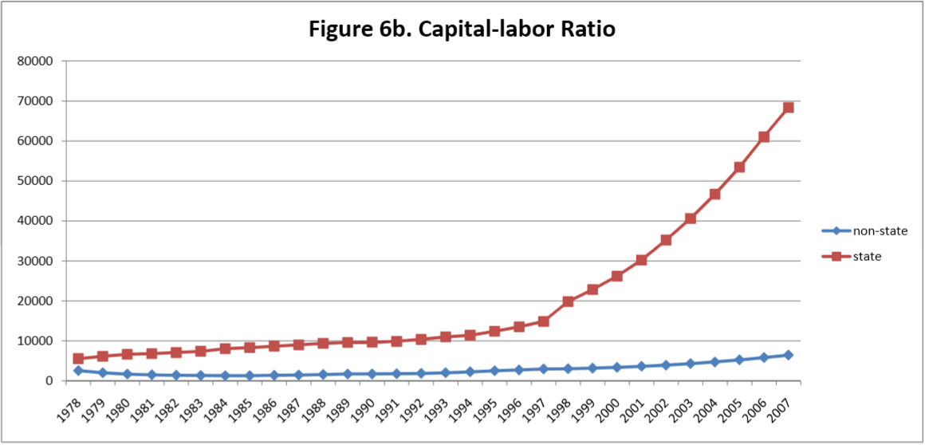
Patterns: TFP and Capital
Where did demand for capital growth come from?
The driving forces of open capital markets since China joined WTO.
Or as Brandt and Zhu (2010) suggested, the capital market’s distortion made the state-owned sector’s capital share accelerate since 1997, and a government-led accumulation of capital may be one of the drivers.

Slide 24
Patterns: Structural Transformation
What’s the cause shaping MPR consistently greater than 1?
There exist two countervailing forces: the demand and the friction.
What’s the form and cause of demand ?
Main reason: the powerful agricultural TFP growth allows food demand to be met with fewer workers, which triggers labor reallocation (Brandt et al., 2008).
This agricultural TFP growth is mainly attributed to institutional factors
Household Responsibility System enhanced monitoring efficiency (Lin, 1987).
Development of land rental market (Deininger and Jin, 2005).
Reform on land tenure security (Deininger, Jin, and Xia, 2012).
Accessibility and incentives to acquire technologies (Jin, Ma, Huang, Hu, and Rozelle, 2010).

Slide 25
Patterns: Structural Transformation
What’s the form and cause of friction ?
Rigid demographic regulations on urban-rural migration.
high cost of living and education in cities.
Lack of wealth tends to reduce education years of children in rural areas (Brown and Park, 2002), leading to lower human capital endowments.
Structural transformation shapes nearly 80% of urban house price rise, which in turn suppresses the transformation itself (Garriga et al., 2017).
Some urban-biased local governmental policies also lead to urban-rural inequality (Chen and Lu, 2004).

Slide 26
Conclusion: Summary
Our story is based on analysis of China’s factoral and sectoral growth (the 1980s-2017).
Agricultural growth: two phenomenal and stationary patterns
Labor escape since the 1990s.
powerful TFP growth through out the reform.
Non-agricultural growth: time-contingent presentations
Steady contribution of labor migration
Considerable TFP growth before 2001 & rising role of capital accumulation after 2001.
Factoral changes: result from institutional factors
TFP growth in agriculture.
TFP growth & capital accumulation in non-primary industry.
Sectoral labor transformation
Demand vs. Friction: growth of agricultural TFP vs. migration restrictons.

Slide 27
Conclusion: Prospects and Suggestions
Implications of trends in MPR & MPRC
Continuing labor migration as a result of higher agricultural productivity.
Increasing demand of capital accumulation, greater proportion in total growth.
Worries behind MPRC diverging from theoretical value 1
Capital growth cannot be completely ascribed to development of markets.
Unhealthy growth pattern like state-leading may take some role.
Suggestions for Chinese government
Continue to conduct institutional change and prevent expedient measures like state-driving growth, and this is actually the secret of success of the past 40 years.
Focus on active reform by further freeing land markets, deregulating labor migration restrictions, stimulating peasants to cities by subsidy, undercutting the privilege of state-owned enterprises in the capital market, etc.

Slide 28
Thank You!

